Slide 1
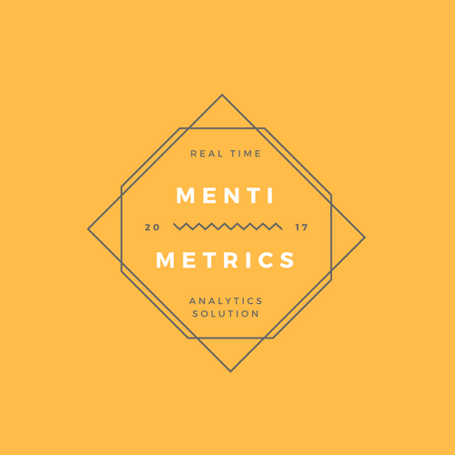
MENTI METRICS
Data Driven Mental Health solutions

Slide 2
MISSION STATEMENT
Providing data analytical solutions to improve the mental health at all levels
Utilise Historical Open Data to derive correlations between unique factors and render them to organisations to improve societal well being.

Slide 3
Why Now ?
We have come to a stage where a human being is no longer behaving has a human being whereas more of a machine. In today’s era we do focus on our physical health, but we forget the more important part of MENTAL HEALTH. In this hustle-bustle there is a need for the administrative organisations to smartly analyse and track efficient data trends and correlate them in a unique manner to make cities smarter and healthier.

Slide 4
How do we analyse mental health levels?
Correlation Factors
Alcohol consumption trends
Smoking Habits
Search Trends – By using open data of Google Trends
Daily working hours in a region
Relationship status
Emotional state of individuals whether male/female

Slide 5
UNDERLYING MAGIC
A logistic regression model which is a machine learning algorithm which outputs the likeliness of depression and suicidal thoughts based on the correlation factors input
A front-end prototype which utilises the output of above algorithm and provides interactive visual information.
Emotional Recognition algorithm which can detect the emotions of an individual and predict his/her anxiety levels, Gender, Race, Age which are utilised while scaling the product to individual level.

Slide 6



Business Model

Slide 7



Our Clients
Governmental
Agencies
Corporate Giants
Individuals
(Future Plan)

Slide 8
Unique Value Propositions
Tracking mental health at all levels
Build smart cities with mentally healthy lifestyles
Correlating unique and unconventional factors affecting mental health

Slide 9
Roadmap
12 Months
Future Plans
Scaling the product to the individual level using artificial intelligence.
12 Months
We implement
the trained model in developed countries
Research and training using data and contacting organisations.
6 Months
Establishing Partnerships

Slide 10
Expansion Plan
Scaling the product to a level where it can be used for an individual, and utilising the sets to implement IOT in order to make buildings smart, by having smart rooms which would use voice recognition and artificial intelligence to counsel individuals to reduce their stress levels.

Slide 11





Team Members
Subhayan Roy
Ankit Tibrewal
Abhimanyue Singh
Omer Raza
Mohammad Ahmad

Slide 12
« Every 40 seconds, one person commits suicide, we aim to solve this problem by saving a life at a time »

Slide 13
THANK YOU

Slide 14
Gradient 3

Slide 15
Gradient 4

Slide 16
Gradient 5

